Slide 1
Chapter 7
Vibrations & Waves

Slide 2


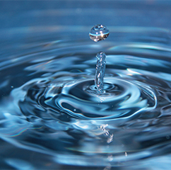
Waves

Slide 3

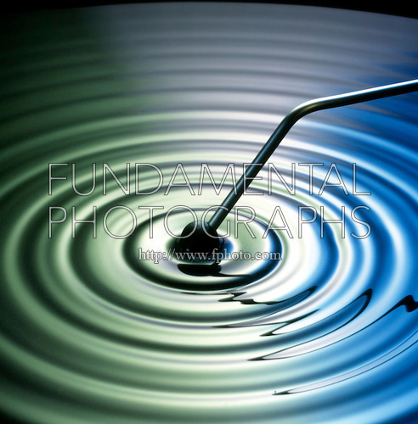
Waves
A Wave is a disturbance that travels from place to place carrying with it energy.

Slide 4


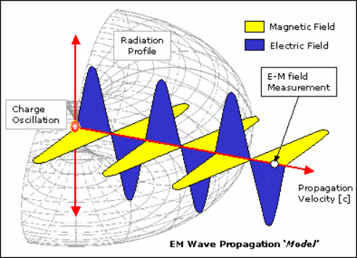
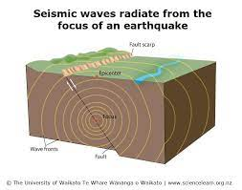

Slide 5
How are waves produced?
First: a certain source delivers some energy to a certain medium, as a result a disturbance is produced.
Second: The produced disturbance doesn't keep in Local. However, it travels from place to place carrying with it the energy.

Slide 6
Notes
The material through which the wave it travels is called medium.
As waves travel through a medium they carry energy but not matter (I.E. evident the particles of the medium).

Slide 7
Wave characteristics
Period T(s)
Frequency f(Hz)
Amplitude A(m)
Wavelength λ(m) : it is the distance traveled by the wave during a period
(1 cycle).

Slide 8





- What Are Waves?

Slide 9
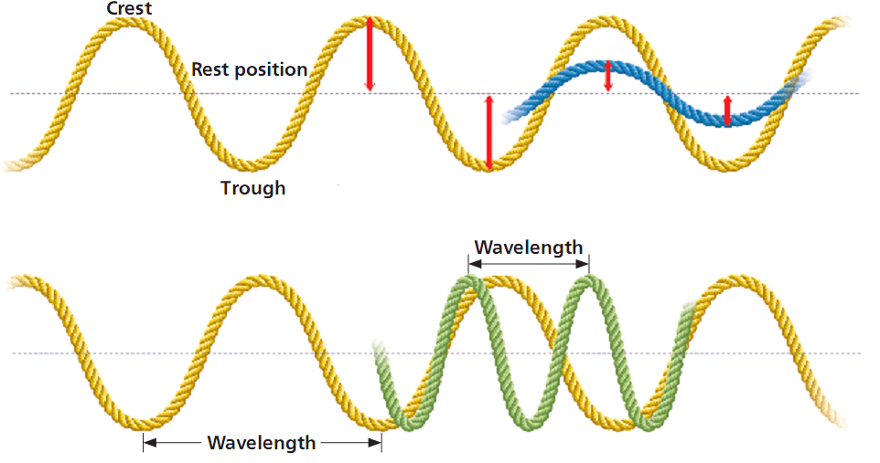
Measuring Wavelength
A simple way to find the wavelength is to measure the distance between two adjacent similar points of the wave, such as from crest to crest or from trough to trough.
The distances between adjacent crests or troughs in the waveform are equal.

Slide 10
Comparing Amplitudes & wavelengths

Slide 11
FREQUENCY
The vibrating object that causes a sine wave always has a characteristic frequency.
Because this motion is transferred to the particles of the medium, the frequency of vibration of the particles is equal to the frequency of the source.
When the vibrating particles of the medium complete one full cycle, one complete wavelength passes any given point.
Thus, wave frequency describes the number of waves that pass a given point in a unit of time.

Slide 12
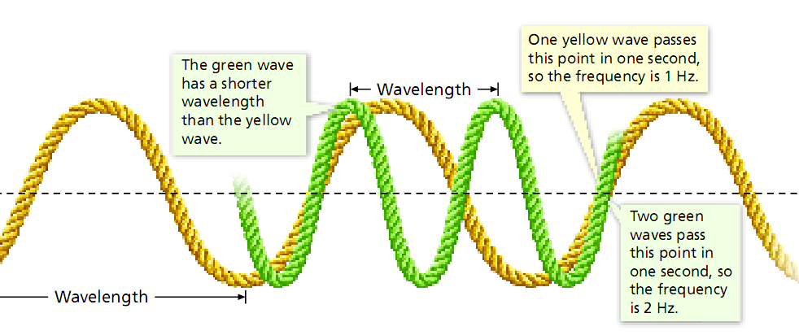

Slide 13
WAVE SPEED
As you saw earlier in this chapter, frequency and period are inversely related.
Substituting this frequency relationship into the previous equation for speed gives a new equation for the speed of a wave.

Slide 14
The speed of a wave in a given medium
The speed of a wave is how far the wave travels in a given length of time.
The speed of a mechanical wave is constant for any given medium.
For example, at a concert, sound waves from different instruments reach your ears at the same moment, even when the frequencies of the sound waves are different.
Thus, although the frequencies and wavelengths of the sounds produced by each instrument may be different, the product of the frequency and wavelength is always the same at the same temperature.
The speed of a wave changes only when the wave moves from one medium to another or when certain properties of the medium (such as temperature) are varied.

Slide 15
Frequency &wavelength are inversely proportional
Speed = Wavelength x Frequency
12 = 2 x 6
12 = 3 x 4
Speed did not change
W.L. increased
Freq. decreased

Slide 16
